Slide 1
FINA 3332 Week 10
TUESDAY
Discussion: Articles
“Bonds”, BDH, Chapter 6
Practice questions for Exam 2 are posted
THURSDAY
[15 minutes] Finish Chapter 6
REVIEW SESSION
These notes should be used by enrolled students only.
May not be copied, duplicated, or posted on a publicly available website.

Slide 2
FINA 3332 Lecture 15 – 3/21/2017
Discussion: Articles
“Bonds”, BDH, Chapter 6
These notes should be used by enrolled students only.
May not be copied, duplicated, or posted on a publicly available website.

Slide 3
*EXAM 2*
3/28, Tuesday at 11:30 a.m. (75 minutes)
Location: MH 160, please arrive 10 minutes early
No books, class notes, or formula sheets are allowed.
PLEASE CHECK SYLLABUS FOR EXAM DETAILS, IN PARTICULAR:
A formula sheet will be provided by the instructor (attached to the exam), and it will be posted on Blackboard this week.
A calculator is required for the exams. Each student must have his / her own calculator. Calculators cannot be shared. Calculators with alpha-numeric capabilities and graphing calculators are not allowed during exams. This calculator policy will be strictly enforced. Each student must read the calculator’s manual carefully at the beginning of the semester. Each student is fully responsible for mastering his / her calculator’s functions and correct use.

Slide 4
*EXAM 2*
PLEASE CHECK SYLLABUS FOR EXAM DETAILS, IN PARTICULAR:
Identification (ID) Policy: Students are required to bring two valid photo IDs for all exams. ID’s must be presented before admittance to the classroom for an exam. On exam days, students should remain in the hall outside the classroom until ID’s can be checked.
Computers, cell phones, and any other devices capable of storing information relevant to the exams (watches, etc.) are not allowed during exams.
During exams, students are required to complete the exam and turn it in to the professor before leaving the room. No breaks are allowed during exams.

Slide 5
*EXAM 2*
A set of practice questions will be posted on Blackboard, and we will have a review session on Thursday. It is very important to work on the practice questions BEFORE the review session.
Exam material: All material covered in class, required readings, and assignments – except for the news articles discussed at the beginning of each class. There will be no questions about these articles.
Check the material covered in class: all notes are posted on Blackboard.
Textbook (BDH) Sections:
Chapter 4, Sections: (4.1), 4.2, 4.3, 4.4, 4.5, 4.6
Chapter 5, Sections: 5.1, 5.2, 5.3 (only what we discussed in class), 5.4
Chapter 6, Sections: 6.1, 6.2, 6.3, 6.4 (only what we discussed in class)
The exam includes short answer questions, and multiple choice questions. If specified, you must “show work” (i.e. provide calculations) in a multiple choice question. For questions requiring the use of a calculator, if you decide to use a financial calculator, you must write down the formula you applied and the inputs to the calculator.

Slide 6
Discussion: Article 1

Slide 7
Discussion: Article 2

Slide 8
Financing
Decision
(raising $)
Financial
Manager
Investment
Decision
(spending $)
Cash flow

Slide 9
-- Brief Review (Last Class) --

Slide 10
Chapter 6
Bonds

Slide 11
Bonds
Bond Terminology
Zero-Coupon Bonds
Coupon Bonds
Why Bond Prices Change
Corporate Bonds

Slide 12
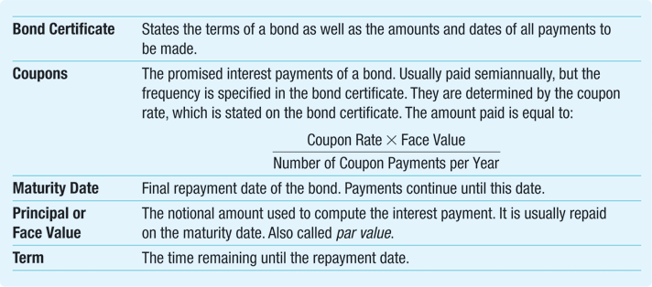
Table 6.1: Review of Bond Terminology
Notes:
12

Slide 13
6.2 Zero-Coupon Bonds
A zero-coupon bond does not make coupon (i.e. interest) payments
Only two cash flows
The bond’s market price at the time of purchase
The bond’s face value at maturity
Treasury Bills are zero-coupon U.S. government bonds with maturity of up to one year
Always sells at a discount (a price lower than face value), so they are also called pure discount bonds

Slide 14
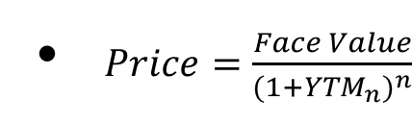

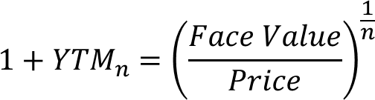
6.2 Zero-Coupon Bonds
Yield to Maturity (YTM) of a Zero-Coupon Bond
The discount rate that sets the present value of the promised bond payments equal to the current market price of the bond
More generally: the YTM of a zero-coupon bond with n periods to maturity, current price P, and face value FV solves:

Slide 15
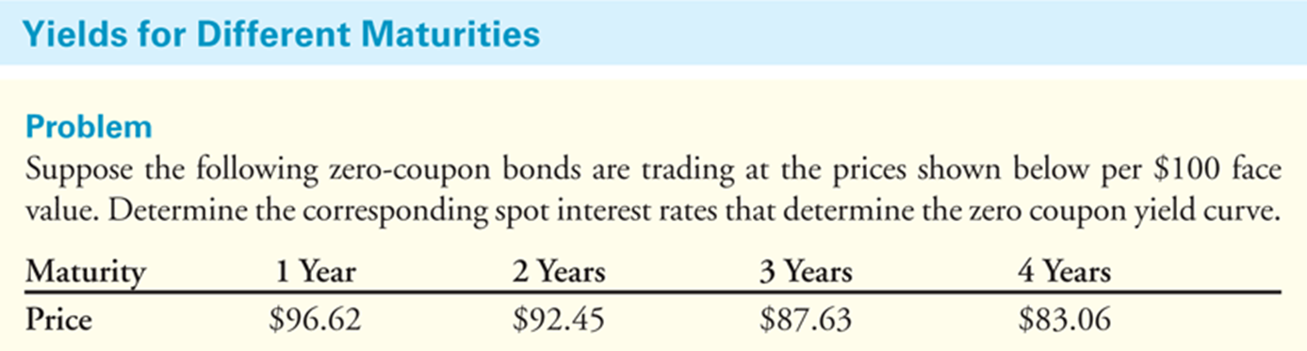
6.2 Zero-Coupon Bonds YTM, Example, Textbook 6.1
Suppose the following zero-coupon bonds are trading at the price shown in the Table below, per $100 face value.
Determine the corresponding yield to maturity for each bond.

Slide 16
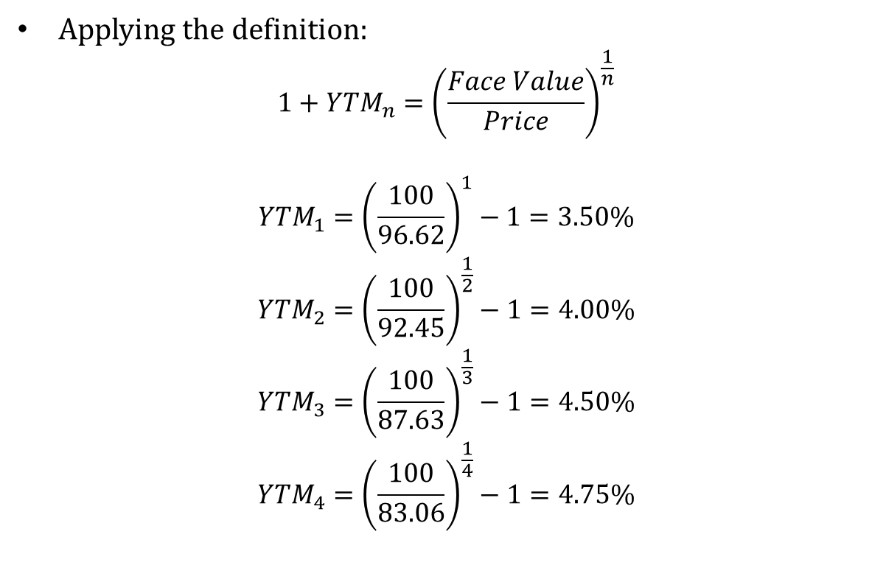
6.2 Zero-Coupon Bonds YTM, Example, Textbook 6.1
Applying the definition:
$${1+YTM}_{n}={\left(\frac{Face Value}{Price}\right)}^{\frac{1}{n}}$$
$${YTM}_{1}={\left(\frac{100}{96.62}\right)}^{1}−1=3.50\%$$
$${YTM}_{2}={\left(\frac{100}{92.45}\right)}^{\frac{1}{2}}−1=4.00\%$$
$${YTM}_{3}={\left(\frac{100}{87.63}\right)}^{\frac{1}{3}}−1=4.50\%$$
$${YTM}_{4}={\left(\frac{100}{83.06}\right)}^{\frac{1}{4}}−1=4.75\%$$

Slide 17
6.2 Zero-Coupon Bonds YTM, Example, Textbook 6.1
SOLUTION -- Interpretation
Solving for the YTM of a zero-coupon bond is the same process we used to solve for the rate of return in Chapter 4.
Indeed, the YTM is the rate of return of buying the bond.

Slide 18
-- End of Review --

Slide 19

6.2 Zero-Coupon Bonds
Risk-Free Interest Rates
A risk-free zero-coupon bond that matures on date n provides a risk-free return from today until time n
We often refer to this as the risk-free interest rate for that period (n)
Also called spot interest rates
Competitive Markets

Slide 20
6.2 Zero-Coupon Bonds
Risk-Free Interest Rates
Spot interest rates
Default-free, zero-coupon yields
Yield curve: plots the risk-free interest rate for different maturities (since the interest rate usually varies with the maturity of the loan or investment)
These rates are the yields of risk-free zero-coupon bonds

Slide 21
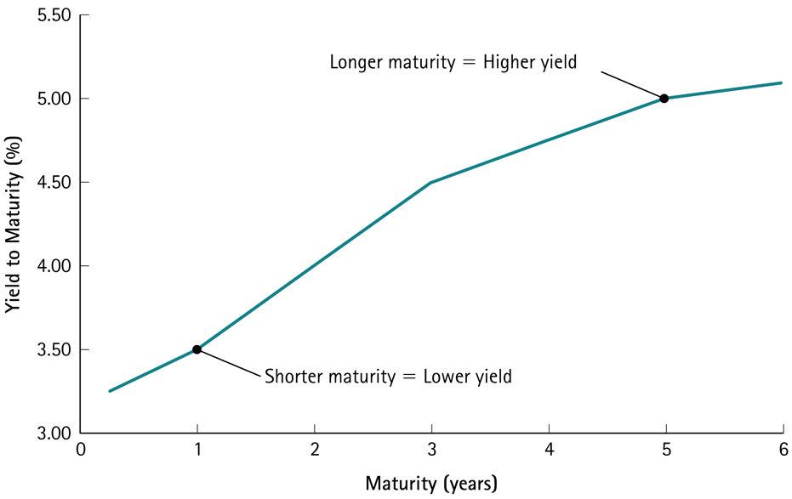
Figure 6.2: Zero-Coupon Yield Curve Consistent with the Bond in Example 6.1
Notes:
21

Slide 22
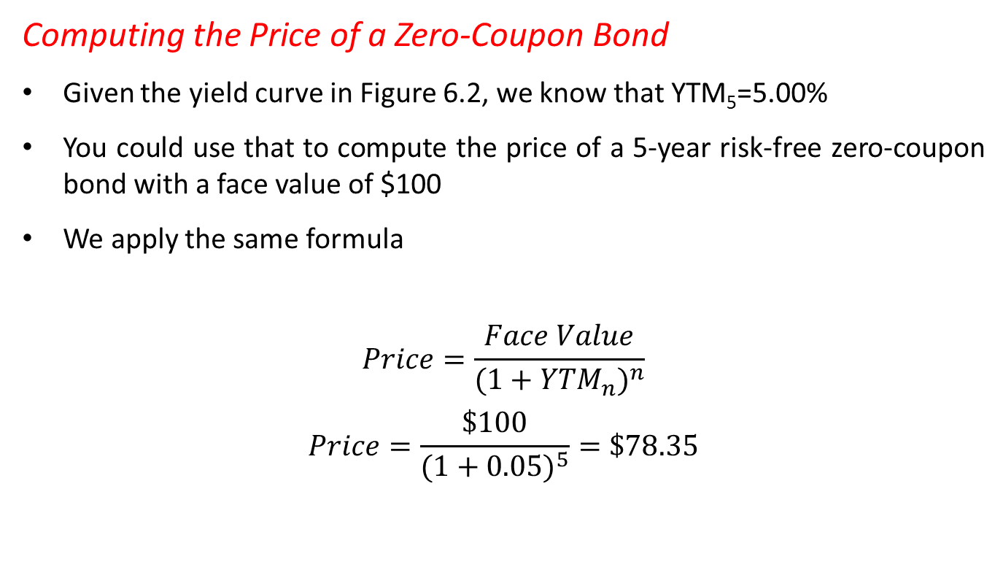
6.2 Zero-Coupon Bonds YTM, Example, Textbook 6.2
Computing the Price of a Zero-Coupon Bond
Given the yield curve in Figure 6.2, we know that YTM₅=5.00%
You could use that to compute the price of a 5-year risk-free zero-coupon bond with a face value of $100
We apply the same formula
$$Price=\frac{Face Value}{({1+{YTM}_{n})}^{n}}$$
$$Price=\frac{\$100}{({1+0.05)}^{5}}=\$78.35$$

Slide 23
6.2 Zero-Coupon Bonds YTM, Example, Textbook 6.2
Computing the Price of a Zero-Coupon Bond
Solution – Interpretation
We can compute the price of a zero-coupon bond simply by computing the present value of the face amount using the bond’s yield to maturity.
Note that the price of the 5-year zero-coupon bond is even lower than the price of the other zero-coupon bonds in Example 6.1, because the face amount is the same but we must wait longer to receive it – TIME VALUE OF MONEY!

Slide 24
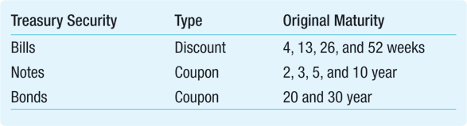
6.3 Coupon Bonds
Coupon Bonds
Pay face value at maturity
Also pay regular coupon interest payments
Two types of U.S. Treasury coupon securities are currently traded in financial markets
Treasury Notes: original maturities from 2 to 10 years
Treasury Bonds: original maturities of more than ten years

Slide 25
Example, U.S. Treasury quotes (selected, as of 3/15/2017)

Slide 26
6.3 Coupon Bonds
Coupon Bond Cash Flows
Return on a coupon bond comes from:
The difference between the purchase price and the principal value
Periodic coupon payments
To compute the yield to maturity of a coupon bond, we need to know the coupon interest payments, and when they are paid

Slide 27
6.3 Coupon Bonds
Coupon Bond Cash Flows
Example 6.3
Assume that it is May 15, 2010 and the U.S. Treasury has just issued securities with May 2015 maturity, $1000 par value and a 2.2% coupon rate with semiannual coupons.
Since the original maturity is only 5 years, these would be called “notes” as opposed to “bonds”.
The first coupon payment will be paid on November 15, 2010.
What cash flows will you receive if you hold this note until maturity?

Slide 28
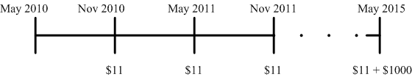
6.3 Coupon Bonds
Coupon Bond Cash Flows
Example 6.3 -- Solution
The face value of this note is $1000.
Because this note pays coupons semiannually, you will receive a coupon payment every six months of CPN=($1,000 x 2.2%)/2=$11.
Here is the timeline based on a six-month period and there are a total of 10 cash flows:
Note that the last payment occurs five years (ten six-month periods) from now and is composed of both a coupon payment of $11 and the face value payment of $1000.

Slide 29
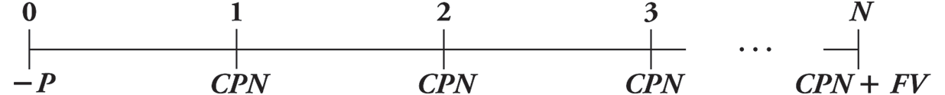
6.3 Coupon Bonds
Yield to Maturity of a Coupon Bond
Cash flows shown in the timeline below:
Coupon bonds have many cash flows, complicating the yield to maturity calculation

Slide 30
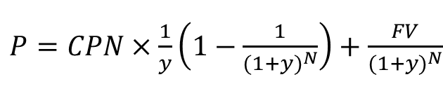
6.3 Coupon Bonds
Yield to Maturity of a Coupon Bond
The YTM is the rate of return of investing in the bond and holding it to maturity.
The YTM is the discount rate that equates the present value of the bond’s remaining cash flows to its current price
Annuity
Yield to Maturity of a Coupon Bond solves the equation:
Bond Price
PV of Annuity

Slide 31
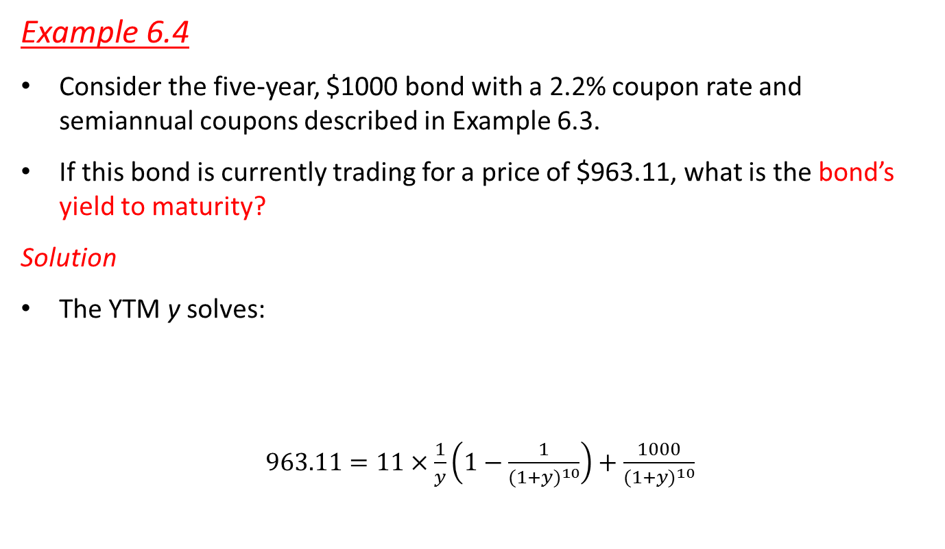
Example, Calculating YTM
Example 6.4
Consider the five-year, $1000 bond with a 2.2% coupon rate and semiannual coupons described in Example 6.3.
If this bond is currently trading for a price of $963.11, what is the bond’s yield to maturity?
Solution
The YTM y solves:
$963.11=11×\frac{1}{y}\left(1−\frac{1}{{(1+y)}^{10}}\right)+\frac{1000}{{(1+y)}^{10}}$
Notes:
Fv= 1000
Coupon rate= 5%
Cpn=50
N=3yrs
Y=6%
p= 50/.06 (1- 1/1.06^3) + 1000/1.06^3

Slide 32
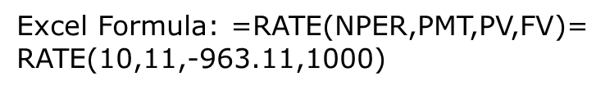

Example, Calculating YTM
Example 6.4 -- Solution
How to solve the equation?
$963.11=11×\frac{1}{y}\left(1−\frac{1}{{(1+y)}^{10}}\right)+\frac{1000}{{(1+y)}^{10}}$
Trial- and-error
Excel

Slide 33
Example, Calculating YTM
Example 6.4 -- Solution
Therefore, y = 1.50%.
Because the bond pays coupons semiannually, this yield is for a six-month period.
We convert it to an APR by multiplying by the number of coupon payments per year.
Thus the bond has a yield to maturity equal to a 3.0% APR with semiannual compounding.

Slide 34
Example, Calculating YTM
Example 6.4 -- Interpretation
As the equation shows, the yield to maturity is the discount rate that equates the present value of the bond’s cash flows with its price.
Note that the YTM is higher than the coupon rate and the price is lower than the par value. We will discuss why in the next section.
**PLEASE work on example 6.5 at home, and we can discuss any questions next class**

Slide 35
6.3 Coupon Bonds
Coupon Bond Price Quotes
Prices and yields are often used interchangeably
Bond traders usually quote yields rather than prices
One advantage is that the yield is independent of the face value of the bond
When prices are quoted in the bond market, they are conventionally quoted per $100 face value
Example: www.finra.org/marketdata

Slide 36
In-Class Application Calculating Bond Prices using YTM
Problem
Notes:
APR: semiannual compounding 6.30%
APR/2= 6.30/2= 3.10%
FV (to determine coupon rate)=$1000/2= $500
Coupon rate= 5.0%
N= 5yrs *2 = 10
CPN= (1000*.05)/2 = 35

Slide 37
6.4 Why Bond Prices Change
Zero-coupon bonds always trade for a discount
Coupon bonds may trade at a discount or at a premium
Most issuers of coupon bonds choose a coupon rate so that the bonds will initially trade at, or very close to, par
After the issue date, the market price of a bond changes over time. Why?
Effect of interest rate changes on bond prices
Effect of time on bond prices

Slide 38
6.4 Why Bond Prices Change
Coupon bonds
Discount
A bond is selling at a discount if the price is less than the face value.
Par
A bond is selling at par if the price is equal to the face value.
Premium
A bond is selling at a premium if the price is greater than the face value.

Slide 39
6.4 Why Bond Prices Change
Interest Rate Changes and Bond Prices
If a bond sells at par the only return investors will earn is from the coupons that the bond pays
Therefore, the bond’s coupon rate will exactly equal its yield to maturity
As interest rates in the economy fluctuate, the yields that investors demand will also change

Slide 40
6.4 Why Bond Prices Change
Interest Rate Changes and Bond Prices
Example
A company issues a bond when market interest rates imply a YTM of 8%, setting the coupon rate to be 8%.
Now suppose the interest rate increases so that new bonds have a YTM of 9%. These new bonds would have a coupon rate of 9% and FV of $1000.
Your existing bond was issued when rates were lower, so interest payments are always going to be $80 per year until maturity – because the cash flows are lower, this bond must have a lower price than the 9% bond.

Slide 41
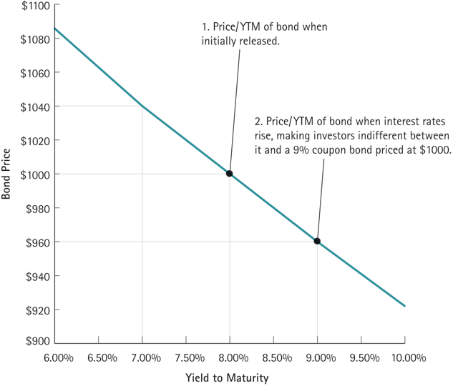
Figure 6.3: A Bond’s Price vs. Its Yield

Slide 42
6.4 Why Bond Prices Change
Interest Rate Changes and Bond Prices
General Result
There is an inverse relationship between interest rates and bond prices
As interest rates and bond yields rise, bond prices fall
As interest rates and bond yields fall, bond prices rise

Slide 43
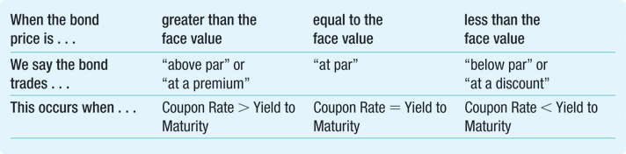
Table 6.3: Bond Prices Immediately After a Coupon Payment
Notes:
43

Slide 44
6.4 Why Bond Prices Change
Interest Rate Changes and Bond Prices
Example, Textbook 6.6
Consider three 30-year bonds with annual coupon payments.
One bond has a 10% coupon rate, one has a 5% coupon rate, and one has a 3% coupon rate.
If the yield to maturity of each bond is 5%, what is the price of each bond per $100 face value?
Which bond trades at a premium, which trades at a discount, and which trades at par?

Slide 45
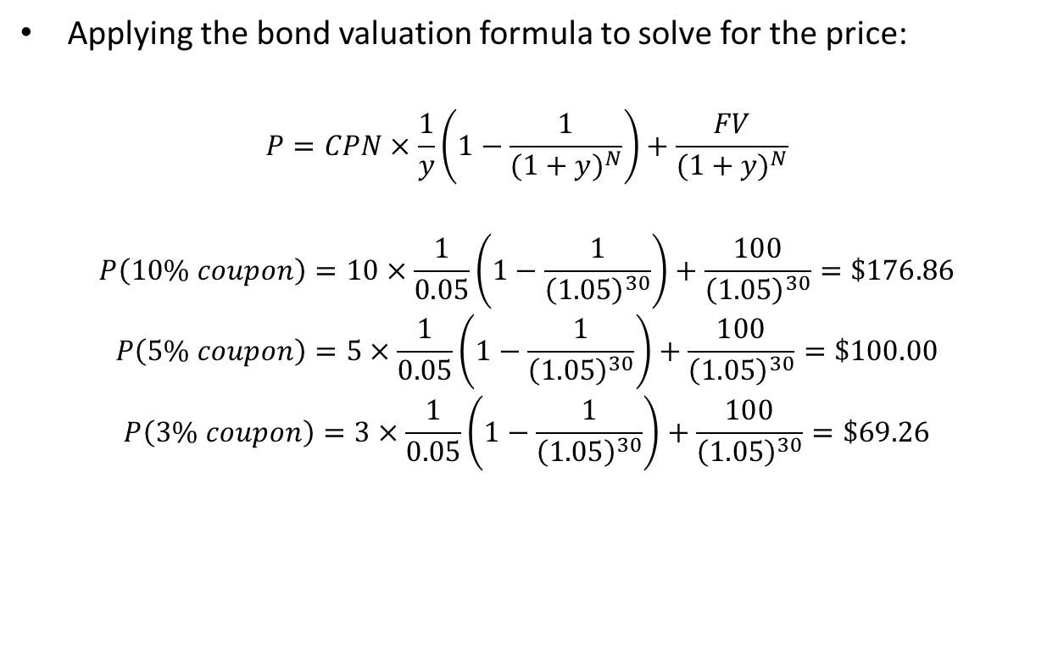
6.4 Why Bond Prices Change
Applying the bond valuation formula to solve for the price:

Slide 46
-- To be continued next class –
**Please bring these slides on Thursday**

Slide 47
Next Class
Finish these set of notes [Section 6.4]
REVIEW SESSION – DO NOT MISS IT!

Slide 48
6.4 Why Bond Prices Change
Time and Bond Prices
Holding all other things constant (i.e. no change in the YTM), the price of discount or premium bonds will move towards the face value over time
For coupon bonds: prices rise between coupon payments, but drop on the coupon date, reflecting the amount of the coupon payment

Slide 49
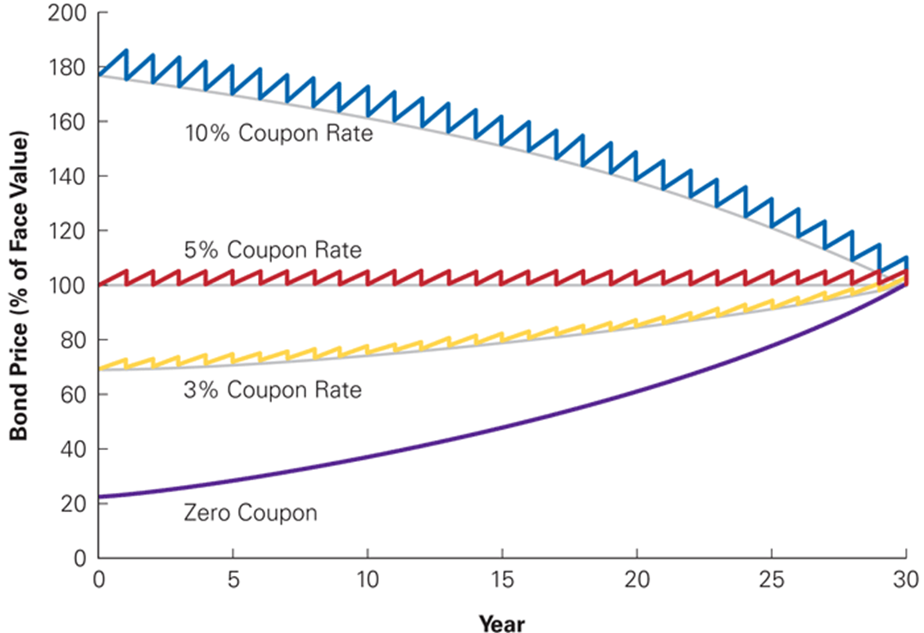
Figure 6.4: The Effect of Time on Bond Prices

Slide 50
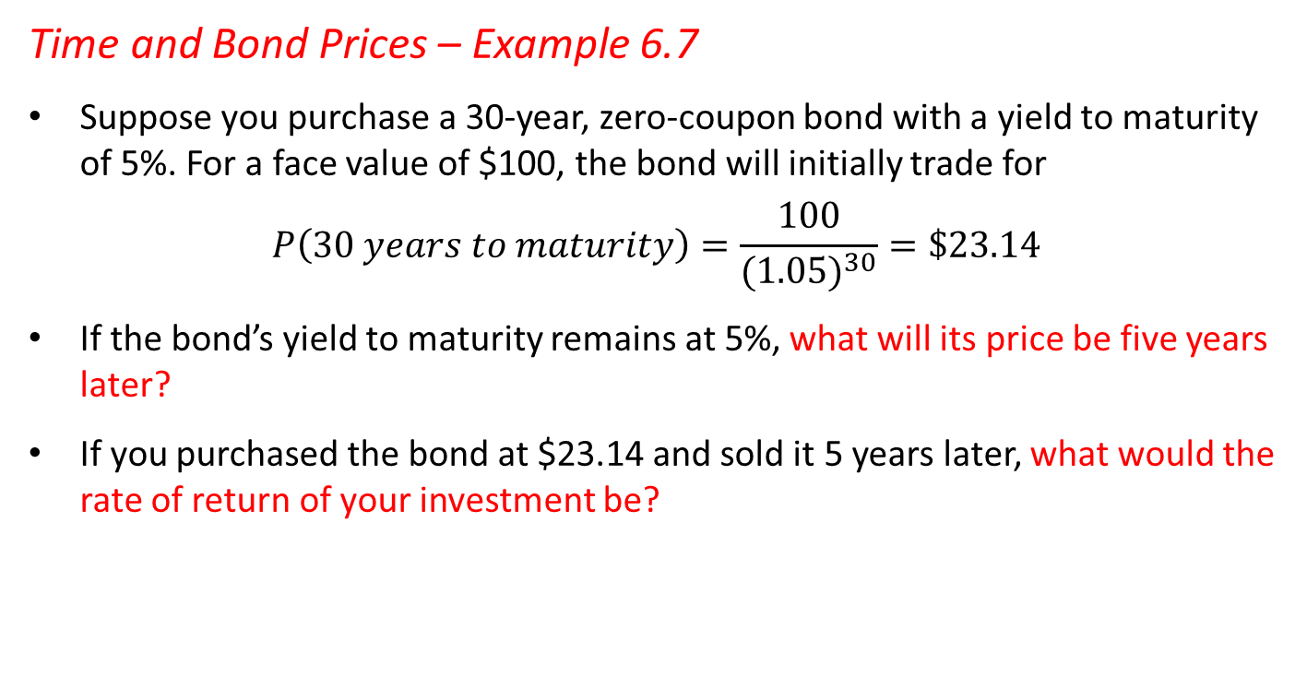
6.4 Why Bond Prices Change
Time and Bond Prices – Example 6.7
Suppose you purchase a 30-year, zero-coupon bond with a yield to maturity of 5%. For a face value of $100, the bond will initially trade for
$$P\left(30 years to maturity\right)=\frac{100}{{(1.05)}^{30}}=\$23.14$$
If the bond’s yield to maturity remains at 5%, what will its price be five years later?
If you purchased the bond at $23.14 and sold it 5 years later, what would the rate of return of your investment be?

Slide 51
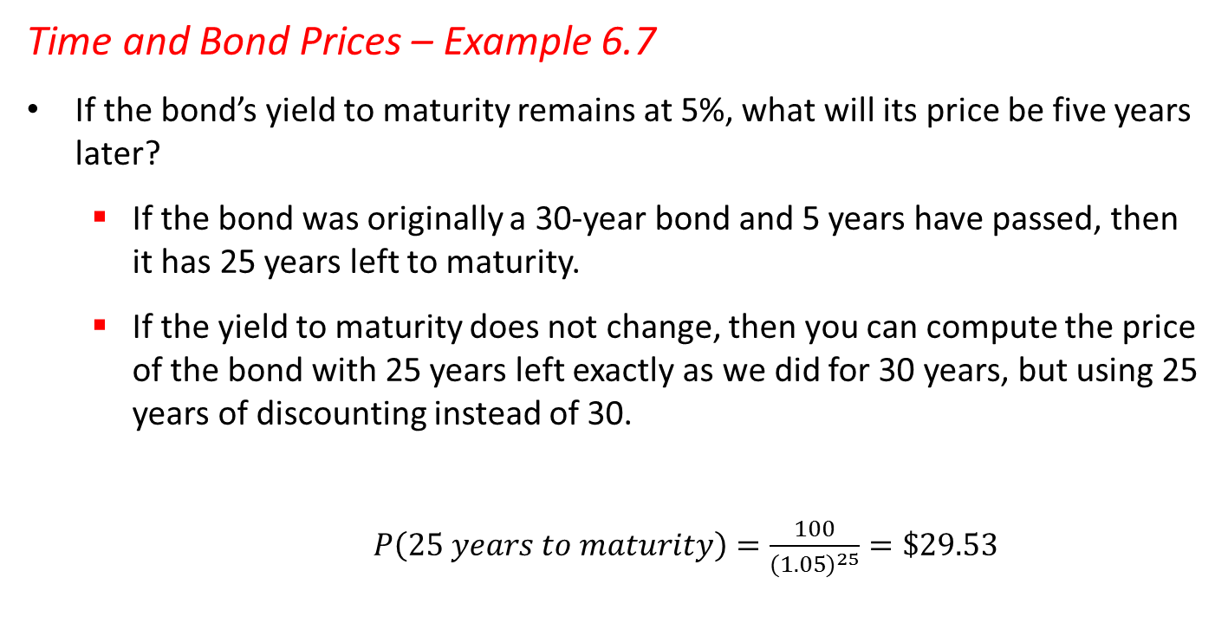
6.4 Why Bond Prices Change
Time and Bond Prices – Example 6.7
If the bond’s yield to maturity remains at 5%, what will its price be five years later?
If the bond was originally a 30-year bond and 5 years have passed, then it has 25 years left to maturity.
If the yield to maturity does not change, then you can compute the price of the bond with 25 years left exactly as we did for 30 years, but using 25 years of discounting instead of 30.

Slide 52
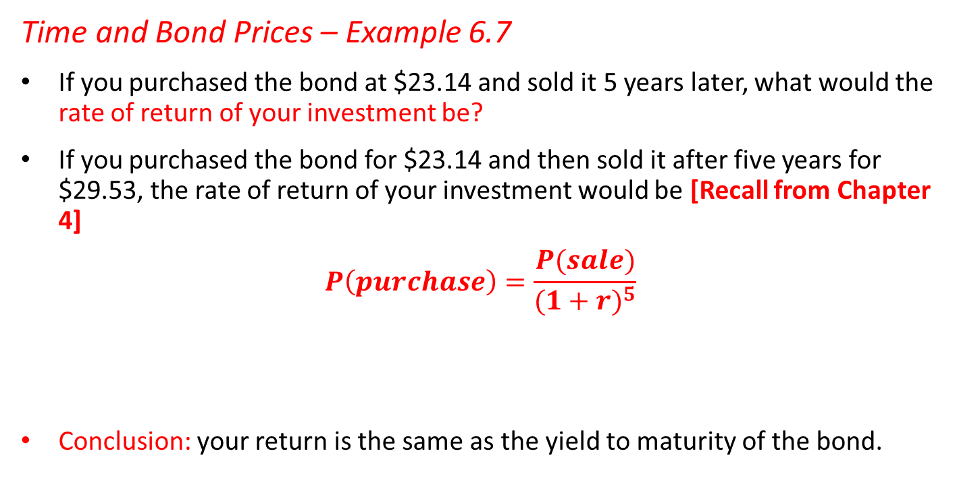
6.4 Why Bond Prices Change
Time and Bond Prices – Example 6.7
If you purchased the bond at $23.14 and sold it 5 years later, what would the rate of return of your investment be?
If you purchased the bond for $23.14 and then sold it after five years for $29.53, the rate of return of your investment would be [Recall from Chapter 4]
Conclusion: your return is the same as the yield to maturity of the bond.

Slide 53
6.4 Why Bond Prices Change
Time and Bond Prices – Example 6.7: Interpretation
Note that the bond price is higher, and hence the discount from its face value is smaller, when there is less time to maturity.
This example illustrates a more general property for bonds.
If a bond’s yield to maturity does not change, then the rate of return of an investment in the bond equals its yield to maturity even if you sell the bond early.

Slide 54
6.4 Why Bond Prices Change
Interest Rate Risk and Bond Prices
Effect of time on bond prices is predictable, but unpredictable changes in rates also affect prices
Bonds with different characteristics will respond differently to changes in interest rates
Investors view long-term bonds to be riskier than short-term bonds

Slide 55
6.4 Why Bond Prices Change
Interest Rate Risk and Bond Prices
There is an inverse relationship between interest rates and bond prices
As interest rates and bond yields rise, bond prices fall
As interest rates and bond yields fall, bond prices rise
Shorter-maturity zero-coupon bonds are less sensitive to changes in interest rates than longer-term zero coupon bonds
Bonds with higher coupon rate are less sensitive to interest rate changes than bonds with lower coupon bonds
[Concept of “Bond Duration” – more in other courses]

Slide 56
6.4 Why Bond Prices Change
Bond Prices in Practice
Bond prices are subject to the effects of both passage of time and changes in interest rates
Prices converge to face value due to the time effect, but move up and down because of changes in yields

Slide 57
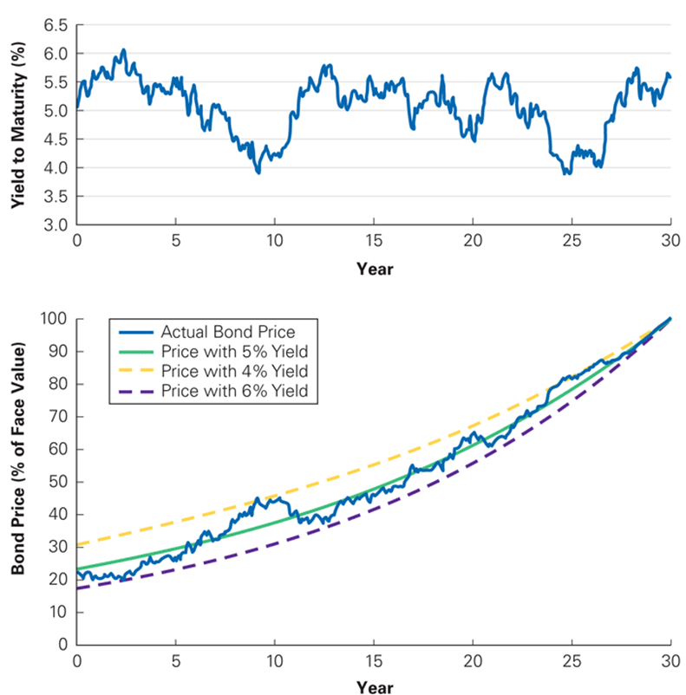
Figure 6.5: Yield to Maturity and Bond Price Fluctuations Over Time

